Slide 1
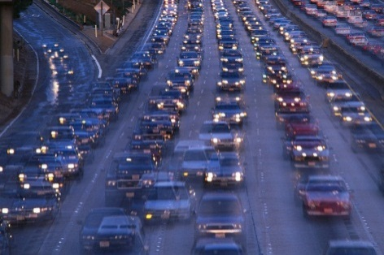
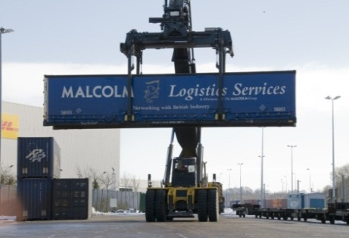
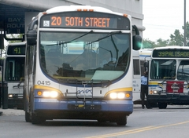
What is the Regional Transportation Plan?
An Informational Session About the Regional Transportation Plan
for the
MPO Policy Committee of the
Birmingham Metropolitan Planning Organization
Darrell L. Howard, AICP, PTP - Deputy Director of Planning
Regional Planning Commission of Greater Birmingham

Slide 2
Review
Required MPO Documents & Plans Federal law and regulations requires that MPOs develop the following:
Core Products
Unified Planning Work Program (UPWP)
Metropolitan Transportation Plan i.e. Regional Transportation Plan (RTP)
Transportation Improvement Program (TIP)
Air Quality Conformity Determination (designated non-attainment/maintenance areas)
Congestion Management Process (CMP)
Performance Monitoring Plan
Public Involvement Plan
Annual Listing of Projects

Slide 3
What is a Regional Transportation Plan?
A Rose by Any other Name… The Regional Transportation Plan is called different things in different places depending on how it is envisioned to be used.
Metropolitan Transportation Plan
Long Range Transportation Plan
Regional Transportation Plan
The Regional Transportation Plan is a long-term blueprint of a region’s transportation system that…
Identifies and analyzes transportation needs of the metropolitan region
Creates a framework for project priorities
Considers the reality of future funding availability

Slide 4
Plan Considerations
Federal Planning Factors Federal regulations direct that the MPO’s planning activities should:
Support economic vitality by enabling global competitiveness
Increase safety for all users
Increase security for all users
Increase accessibility, mobility, and connectivity for people and freight
Protect and enhance the environment, including air quality
Improve quality of life
Promote energy efficiency and conservation
Promote consistency with growth and economic development
Enhance system integration and connectivity
Promote efficient transportation system management and operations
Emphasize system preservation
Note¹: Factors must considered during planning process.
Note ²: Each factor is applied based on local circumstances.

Slide 5
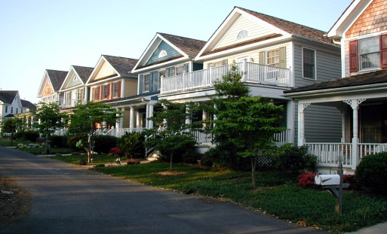
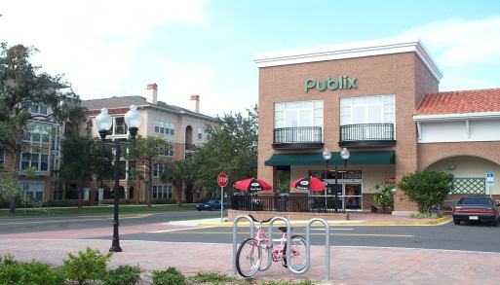
Plan Considerations
Livability Principles Federal guidance encourages consideration of Livability Principles
Provide more transportation choices. Develop safe, reliable, and economical transportation
choices to decrease household transportation costs,
reduce our nation’s dependence on foreign oil, improve
air quality, reduce greenhouse gas emissions, and
promote public health.
Promote equitable, affordable housing. Expand location- and energy-efficient housing choices
for people of all ages, incomes, races, and ethnicities to
increase mobility and lower the combined cost of housing
and transportation.
Enhance economic competitiveness. Improve economic competitiveness through reliable
and timely access to employment centers, educational
opportunities, services and other basic needs by workers,
as well as expanded business access to markets.

Slide 6
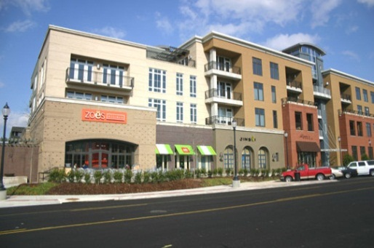
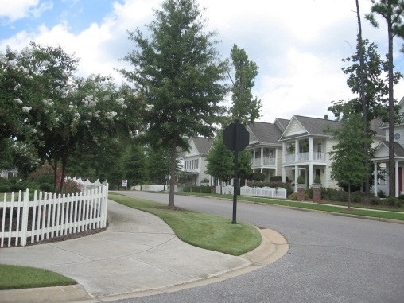
Livability Principles
Livability Principles
Support existing communities. Target federal funding toward existing communities—
through strategies like transit-oriented, mixed-use
development and land recycling—to increase
community revitalization and the efficiency of
public works investments and safeguard rural landscapes.
Coordinate and leverage federal policies and investment. Align federal policies and funding to remove barriers to collaboration, leverage funding, and increase the accountability and effectiveness of all levels of government to plan for future growth, including making smart energy choices such as locally generated renewable energy.
Value communities and neighborhoods. Enhance the unique characteristics of all communities
by investing in healthy, safe, and walkable
neighborhoods—rural, urban, or suburban.

Slide 7
Key Elements of the RTP
Vision, Goals, and Objectives
The RTP is a Roadmap for the Region
Articulates a Vision for how the transportation system will be organized and function
Identifies Broad Goals for elements of the system that achieve the Vision
Sets SMART Objectives for achieving elemental Goals
VISION
GOALS
OBJECTIVES

Slide 8
Key Elements of the RTP
An RTP is a Mix of Policies, Strategies and Technical Analysis
Policies Address
How the MPO will administer the RTP/TIP
Strategies Address
How the MPO will invest in the transportation system over time
How the MPO will advance RTP/TIP recommendations
How the MPO will maintain fiscal constraint
Technical Analysis
Looks at the transportation system by function and mode
Made up of several analytical and functional area plans
State of the Region Report
Congestion Management Plan
Regional Thoroughfare Plan
Active Transportation Plan
Freight Infrastructure Plan
Management Operations and ITS
Performance Monitoring

Slide 9
RTP Themes
Regional Transportation Plan Focus RTP Focus Has Shifted in order to Reflect New Realities
System Preservation “Fix It First” Strategy - Emphasis is on Maintenance and Preservation
Management and Operation Strategies “Make What We Have Work Better” - Emphasis is on Technology, Behavior Change, and Alternative (Active & Transit) Transportation to get the Most “Bang for the Buck”
Repositioning How We Use Federal Funding Focus on Regional Projects and Applying Resources to the Most Expensive and/or Complicated Project
Performance Targets and Measures Set targets and make a make a plan to achieve them.

Slide 10
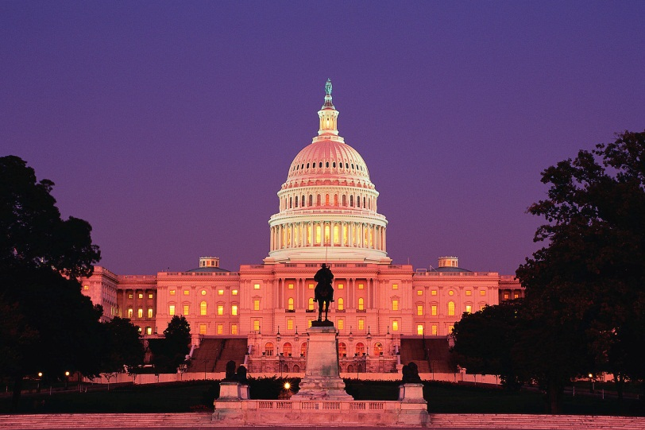
RTP Challenges
Funding Uncertainty
Fiscal Constraint Understand, there will be No New/Increase in
Federal Resources
State Transportation Resources
Local Resources

Slide 11
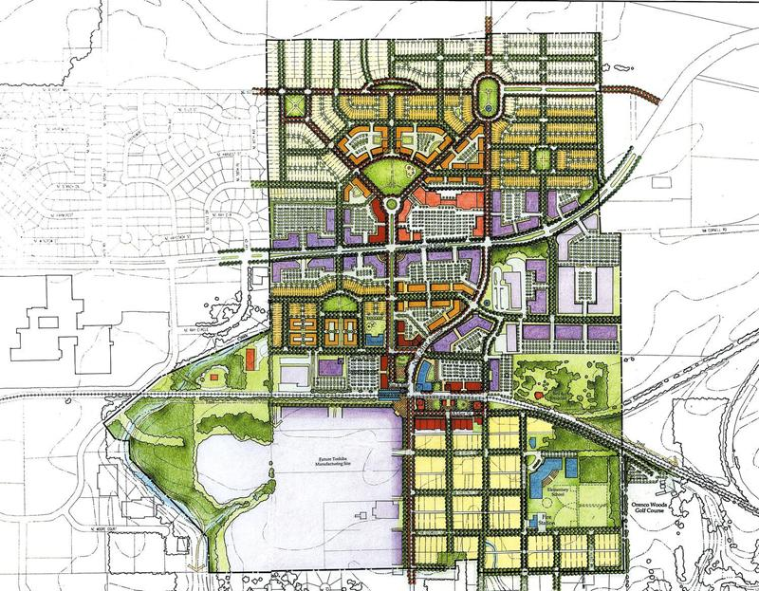
RTP Challenges
Other Challenges
Regional Issues and Needs
Metropolitan Planning Area - Geographic Growth
Fixing Regional Problems with Local Funding
Intra-regional Competition for Scarce Resources
Linking Transportation, Economic
Development, and Land Use
Externalities

Slide 12
For More Information
Website www.RPCGB.org/transportation
Contacts
Darrell L. Howard dhoward@rpcgb.org

